Slide 1
Predicting ratings for reviews stored in NoSQL Database
CMPE 297 - Term Project
Instructor - Prof Gheorghi Guzun
Presented by
Saranya Visvanathan
Sakshi Ahuja
Manish Arigala

Slide 2
Project Description
Problem: predicting ratings for the given reviews Motivation: A lot of e-commerce companies rely on reviews and ratings provided by the customers to build their business models. Also, they are used to provide the better product recommendations. However, there are some cases where a review is disproportionate to the rating given, which could disrupt the business model. Therefore, in these scenarios, it would be beneficial to have a model that could predict ratings corresponding to the review accurately. Solution: Build regression model that predict ratings given reviews using NLP techniques.

Slide 3
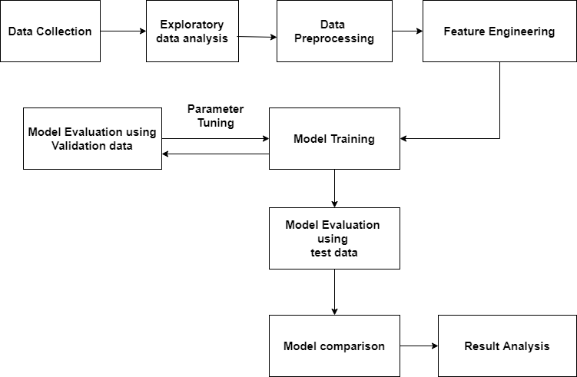
Project Architecture
.

Slide 4
Dataset Preparation
This step is concerned with selecting the subset of available data to train the models. Initially, there was approximately 8GB of data. And, There were approximately 8 million documents and each document had 9 items. Considering the limit of 512 MB of MongoDB Atlas, approximately 1 million records are taken and created as collections. Stars and text are mapped to stars and review respectively. After the processing, each document has a schema as:
{ "_id" : ObjectId("5f9e5249a485dc43db4ce4b8"), "stars" : "5.0", "review" : "This is definitely my favorite fast food sub shop. Ingredients are everything, and everything I see and taste here tells me that they're using top-grade fresh ingredients. The brisket sandwich is probably my favorite... and it's the one my wife ALWAYS gets. Unlike her, I often bounce around the menu to try different things. Definitely a step up from Subway, Quiznos, Jimmy Johns, etc in my opinion. As with all of my reviews, I grade each place relative to what I perceive to be its peers - so five star compared to them." }

Slide 5
Dataset Description
DB Schema
This project uses a yelp dataset’s yelp_academic_dataset_review.json for the ratings prediction. The text and stars keys which represent the reviews and ratings respectively are used in the project.
Database | yelp
Collections | reviewsTrain, reviewsTest
collections Schema | Keys: id, stars, reviews
Dataset size | Training data: 599,995 documents , Test data: 149,995 documents
Dataset type | JSON; Text data & numerical labels; Balanced data

Slide 6
Data Cleaning
Performed the following steps to clean the data
Converting to Lowercase Removing Punctuation Tokenization Removing Stop Words Removing Numbers, URLs, Tags | Lemmatization Removing excessive repeated characters in words Keeping Only meaningful English words

Slide 7
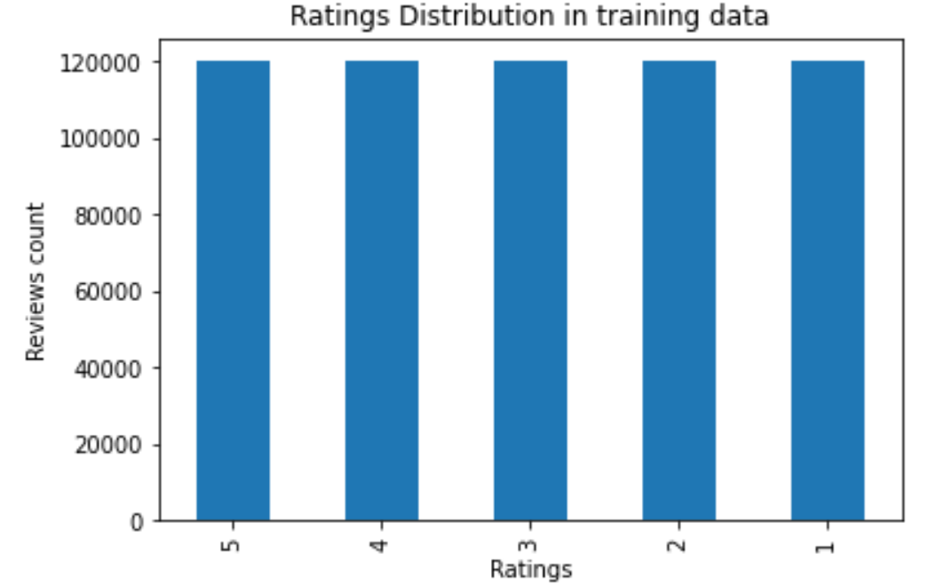
Exploratory Data Analysis
Ratings Distribution
Balanced data: Equal amount of data in all different ratings ranging from 1-5

Slide 8
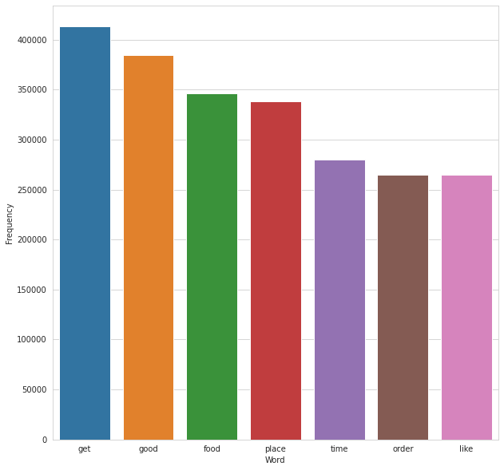
Exploratory Data Analysis
Followed the Bag of Words Approach to find the most frequently used words
Used nltk’s Frequency Distribution to find the most frequently used words
‘Get’, ‘good’, ‘food’ were found to be top 3 most frequently used words

Slide 9
Index creation - Hashed index
Data structure that maps tokens or words to their location in a document or a set of documents
Helps in fast full text searches
Leveraged Python’s hashedindex library to build the inverted index
Iterated through each word from the documents, added its location/locations in the inverted index
However, sklearn’s tfidfVectorizer doesn’t accept this index as its input argument.

Slide 10
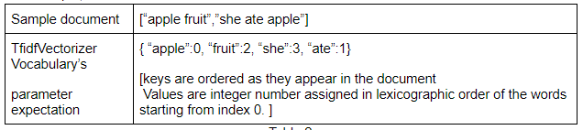
Index creation - tfidf vocabulary
Modified to create a dictionary of words with the word as key and value as its position where the values are assigned in lexicographic order

Slide 11
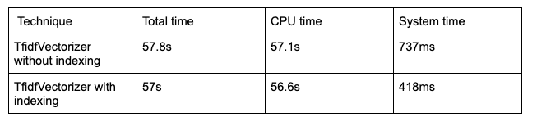
Index performance analysis
TFIDF vectorization on data containing 600,000 documents.
43.2% decrement in system execution time and approx 1% decrement in CPU time
Not much reduction seen maybe because of the optimized implementation of TfidfVectorizer
Since sklearn package has been in the market for a long time, a lot of improvisation has been done on top of it which is evident from its optimized performance without providing any pre-calculated information.

Slide 12
Feature Engineering - Vectorization
Vectorization is the process of converting each review into a vector of numerical values which can be utilized with the ML models.
Tfidf vectorization 1. convert each review into list of words 2. tf-idf score all unique words 3. create vectors for each review.
TfidfVectorizer (sklearn package) is used.
Input: list of Reviews (text data)
Output: sparse matrix contains vectors of each review.
Applied on all training, validation, and test data.

Slide 13
Feature Engineering - Embeddings
Embedding: list of numerical values given to each word.
Helps to create embedding matrix which is utilized in the DL models training.
GloVe embedding: stanford embedding package glove.6B.300d.txt (contains 6 billion tokens and 300 dimensions each). It is stored as embedding dictionary.
The training data is fit to the keras tokenizer which creates a vocabulary of words. Using vocabulary and glove embedding dict, customized embedding matrix is created for DL models training.
Data is splitted into tokens. Each token is replaced with numbers representing indexes of that tokens in the embedding dict.
Applied on all training, validation, and test data.

Slide 14
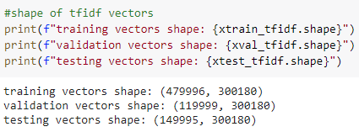
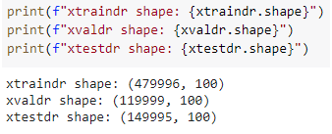
Dimensionality Reduction
Dimensionality reduction helps to reduce the dimensions of the data while maintaining its information. So, it is used to handle large scale of data.
Tfidf created vectors of 300k dimensions which took so long to train even in HPC environment.
So, tfidf dimensions are reduced using linear DR technique, SVD (Singular Value Decomposition) .

Slide 15
Dimensionality reduction - contd
Sklearn’s TruncatedSVD package is used for dimensionality reduction.
Handles sparse matrix. In particular, it is implemented to work well with tfidf vectors.
It is suggested to use 100 dimensions with TruncatedSVD package when vectors are created with tfidf

Slide 16
Model Building
Analysis of simpler to complex models on big data

Slide 17
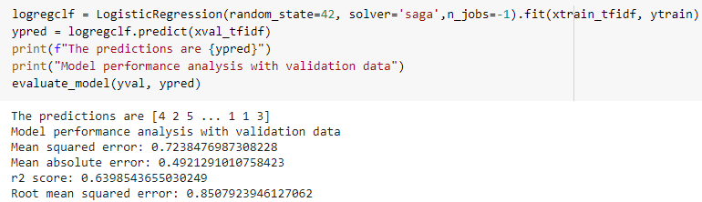
Logistic Regression
It is a linear regression model because it predicts the output by linearly summing up the values of weighted inputs.
Sklearn’s LogisticRegression() package is used.

Slide 18
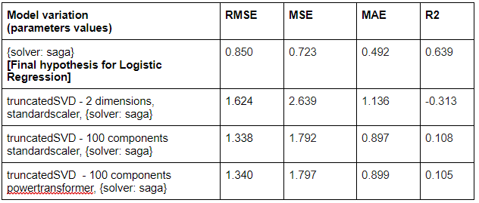
Logistic Regression - validation results

Slide 19
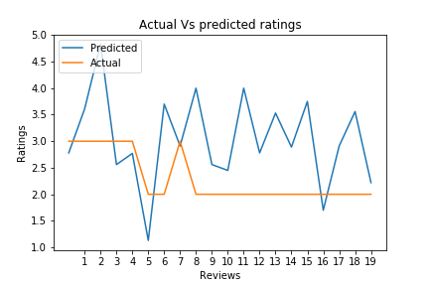
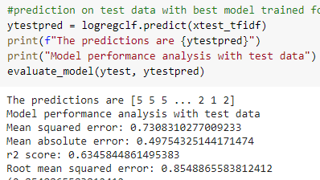
Logistic Regression - Evaluation

Slide 20
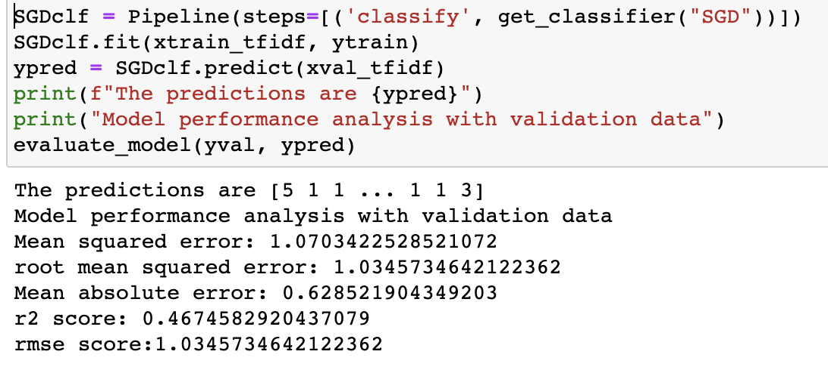
Support vector machines-Stochastic Gradient Classifier Model
In this model , Few samples are selected in a random manner in each iteration. It measures the variability of various parameters in response to changing variables. Package-sklearn SGDClassifier()

Slide 21
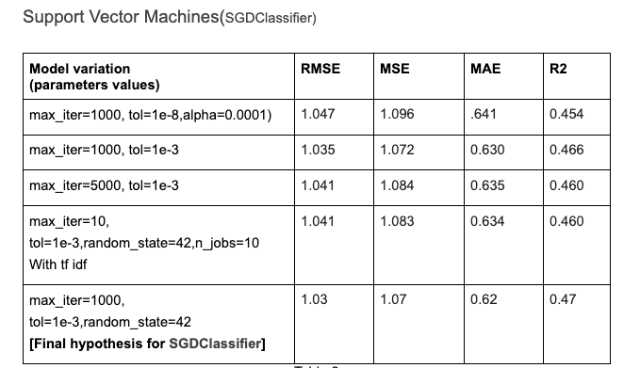
SVM-SGD Validation Results

Slide 22
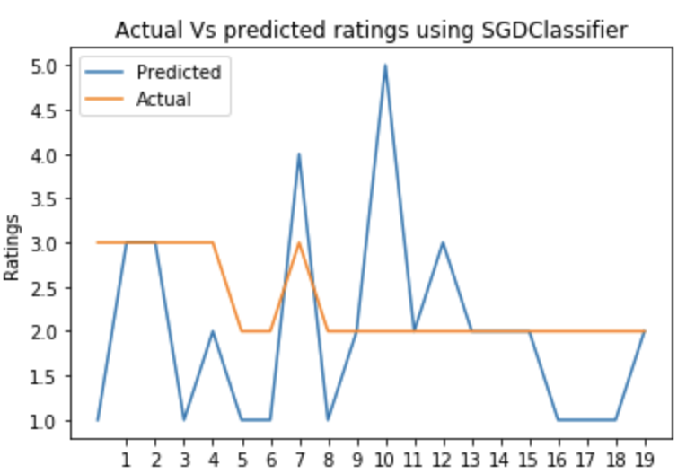
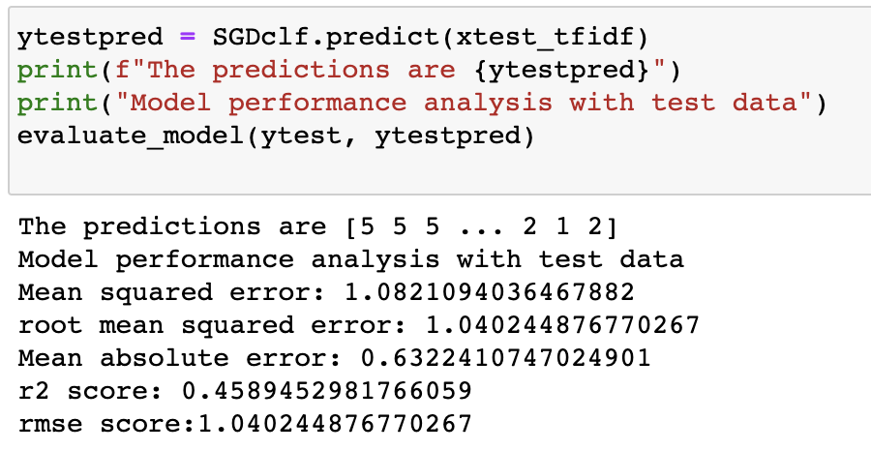
SVM-SGD- Evaluation Results

Slide 23
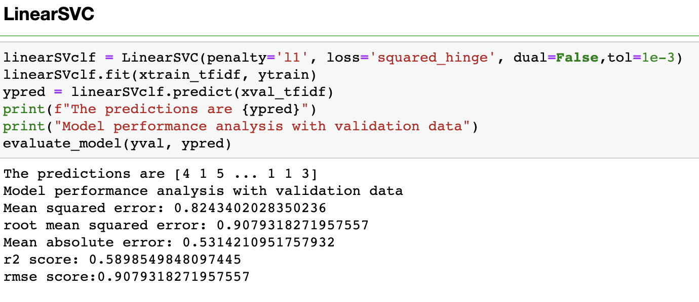
SVM-LinearSVC Model
SVM is one of the accurate learners. It supports both dense and sparse input. For large datasets, the linearSVC works better than SVC(kernel=’linear’) and other svm classes.
Package-sklearn LinearSVC()

Slide 24
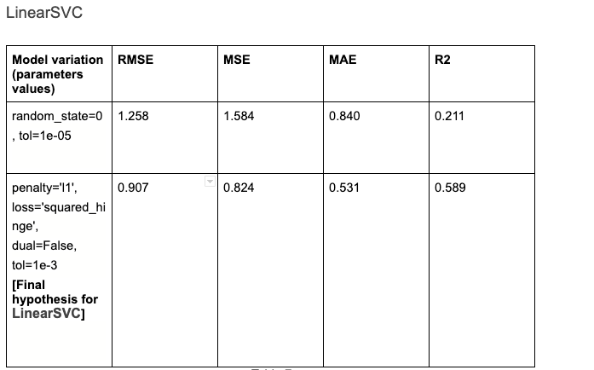
LinearSVC- validation Results

Slide 25
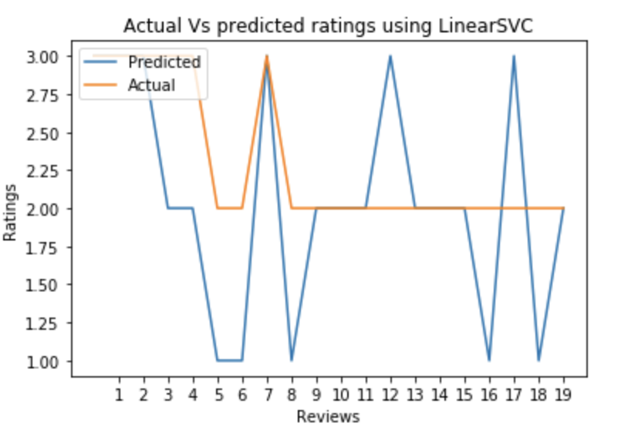
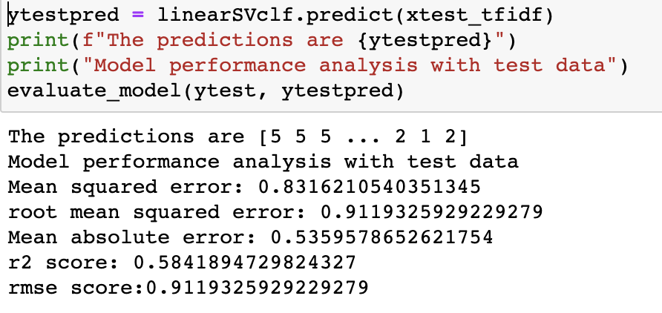
LinearSVC model Evaluation

Slide 26
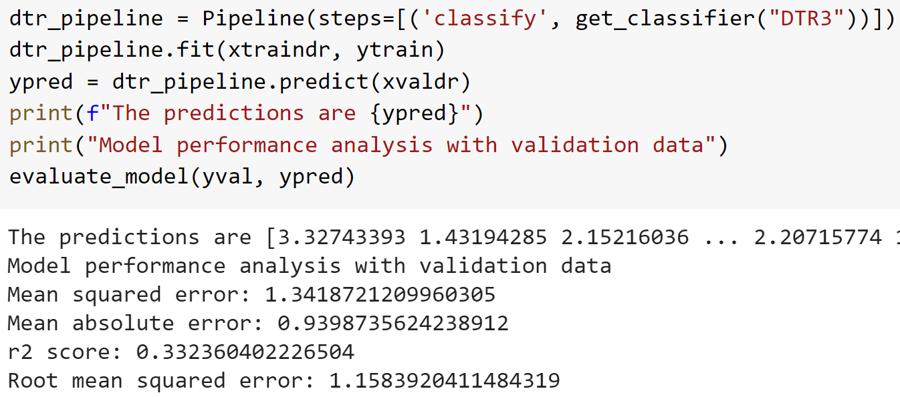
Decision tree Regressor
It creates a tree data structure which would be traversed later to make predictions on the unknown data. Sklearn’s DecisionTreeRegressor package is used.

Slide 27
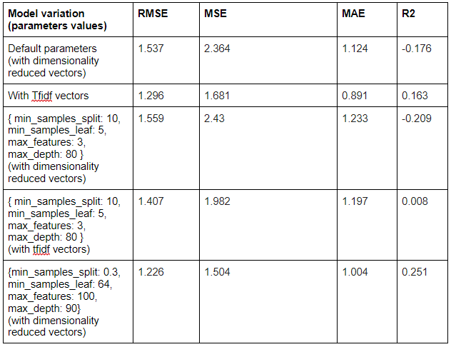
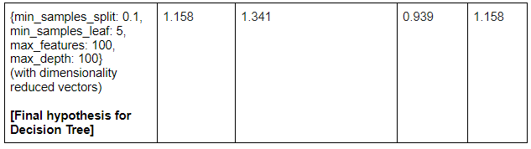
Decision tree Regressor - validation results

Slide 28
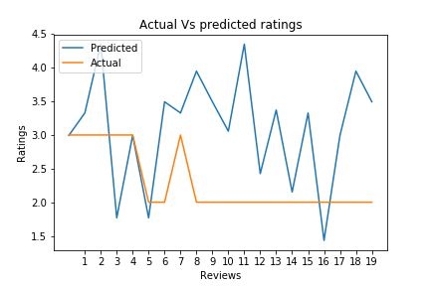
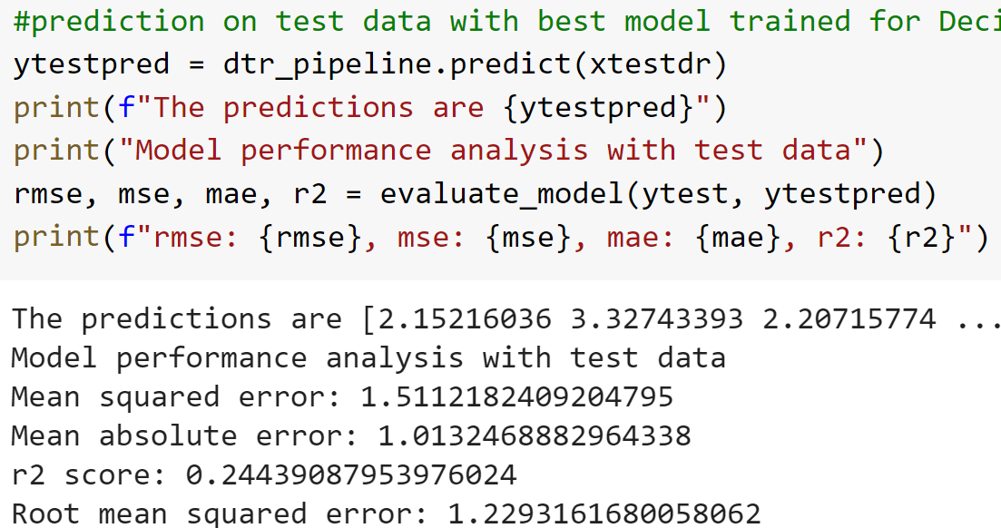
Decision tree Regressor - Evaluation

Slide 29
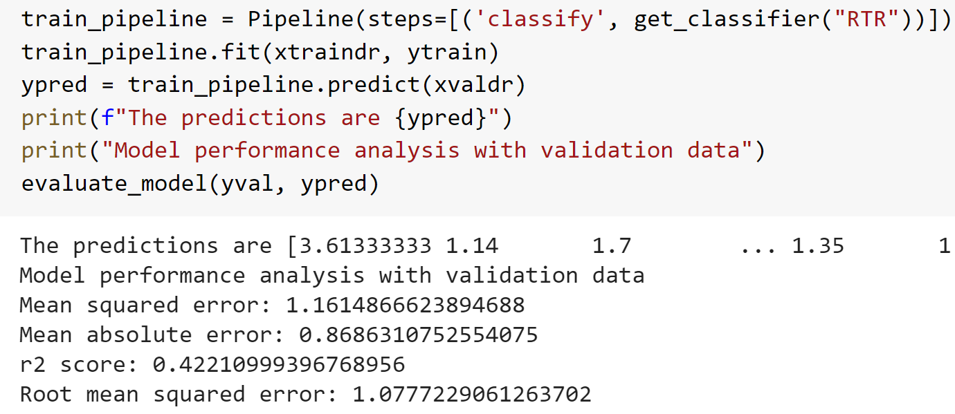
Random Forest Regressor
Ensemble algorithm. Ensemble: a group of predictors, in this case, it has a group of decision trees. Sklearn’s RandomForestRegressor package is used.

Slide 30
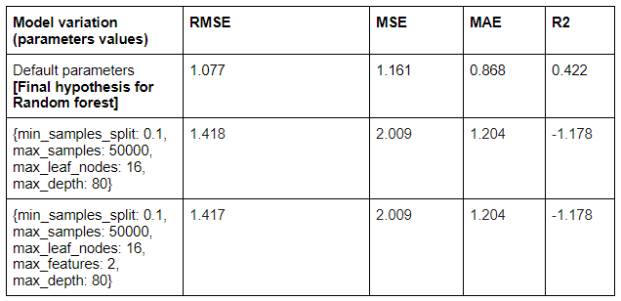
Random Forest Regressor - Validation results

Slide 31
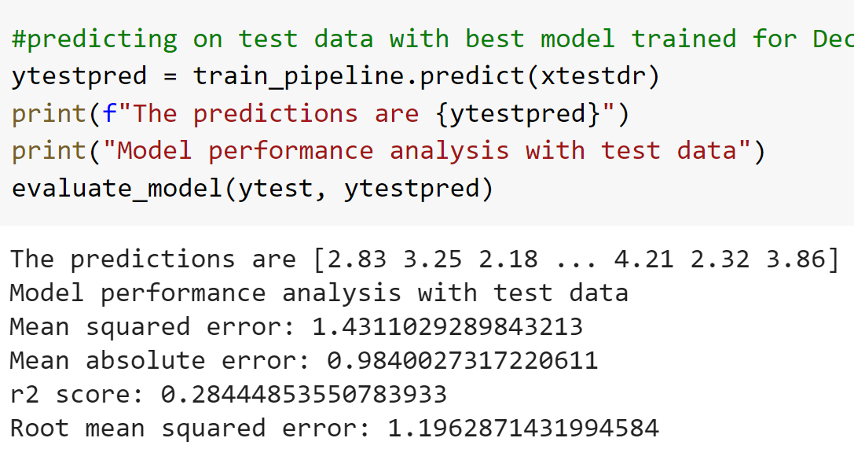
Random Forest Regressor - Evaluation

Slide 32
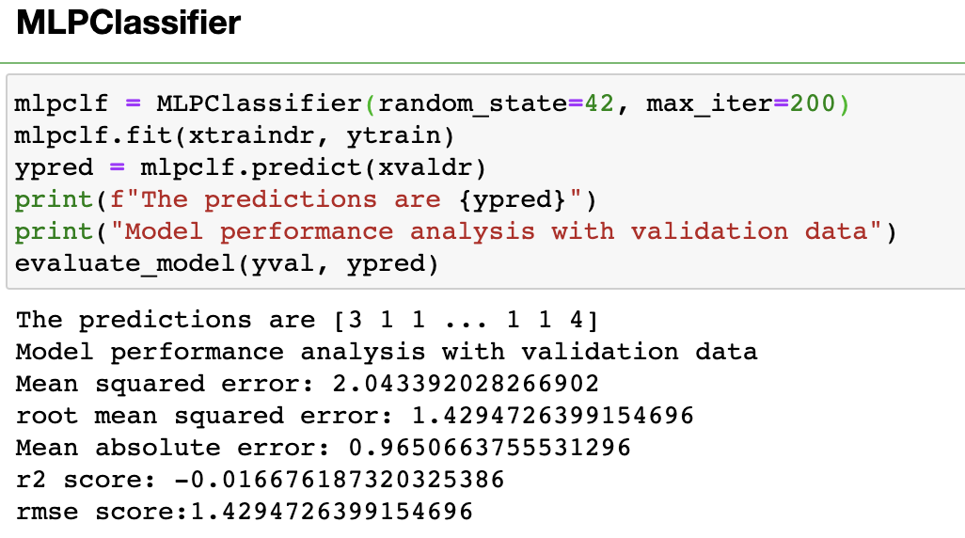
MLP (Multi-layer perceptron)
It consists of multiple layers such as input layer, hidden layers and output layer. It gets a set of data as an input, and passes it to multiple layers and finally predicts a single/multiple output based on the need. Package: sklearn MLPClassifier()

Slide 33
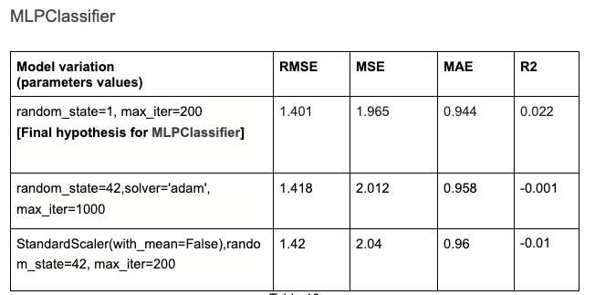
MLP (Multi-layer perceptron) Validation Results

Slide 34
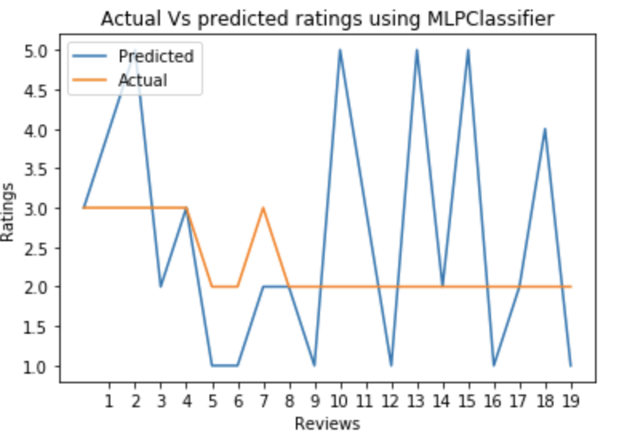
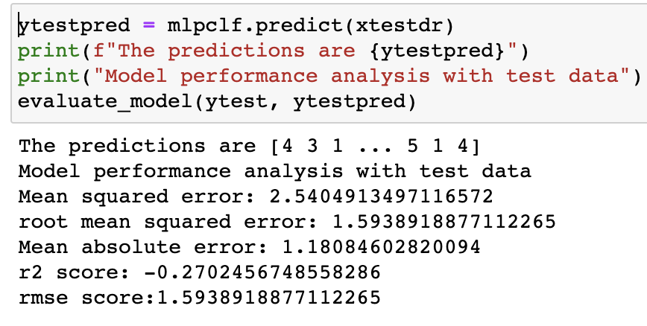
MLP (Multi-layer perceptron) Evaluation Results

Slide 35
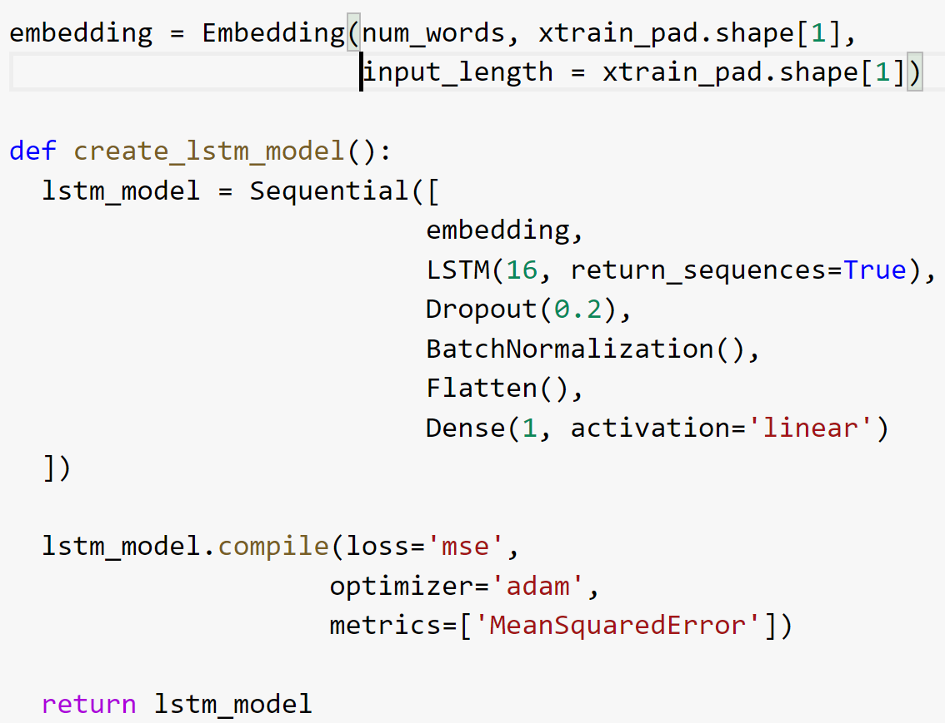
LSTM (Long short term memory)
Recurrent neural network
Along with traditional feed-forward connections, it also stores internal state of the system which helps to decide whether to keep/forget the data.
DL technique can handle large scale of data Keras API’s are used to create, train, validate and evaluate lstm model

Slide 36
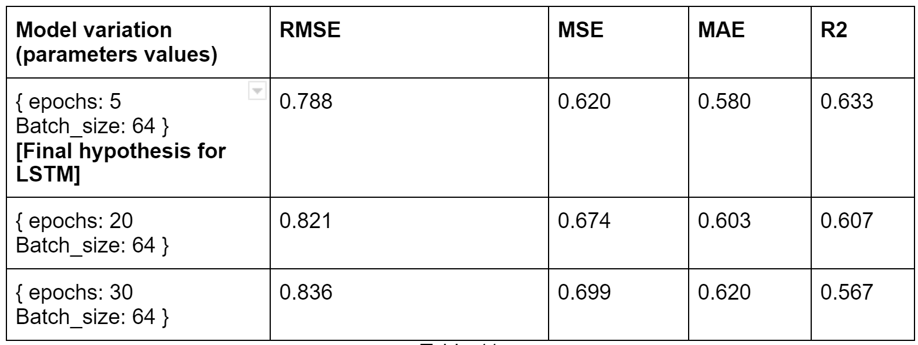
LSTM - validation results

Slide 37
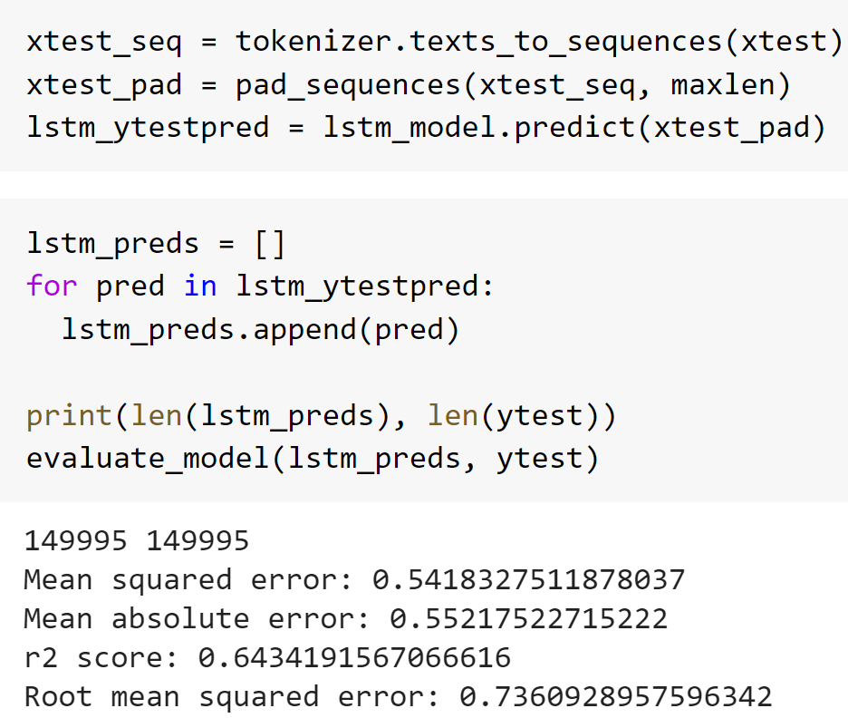
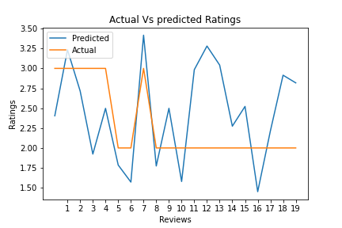
LSTM - Evaluation

Slide 38
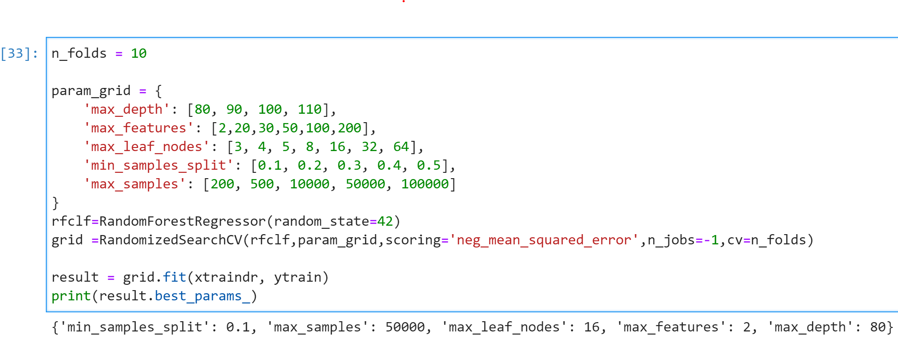
Hyperparameter tuning
Sklearn’s RandomizedSearchCV() is used to tune the parameters.
Given a dictionary of parameters, it tries out different variations and results the parameter combination which provides the better performance which would be decided by the error measure provided as an argument.

Slide 39
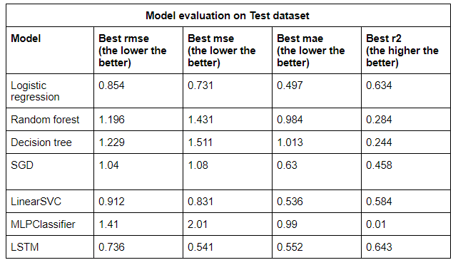
Model Comparison

Slide 40
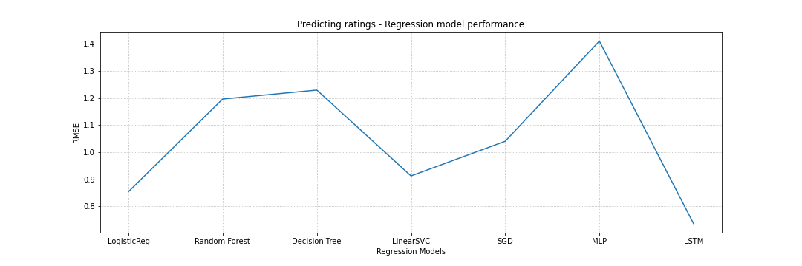
Model Comparison

Slide 41
Result Analysis
Simple models such as LR, SVM performed better than ensemble and tree.
Even with varying parameters, there wasn’t much improvement on error in ML models. The factors that might affected the performance. - created dimensionality reduced vectors of sparse matrix of size 500K X 300K. - First principal component captured only 0.004 variance - After 15th component, all captured only 0.001 varaince But it was needed because of training limitations. (soln: using distributed environment)
Since it is a big dataset, the performance of deep learning model on prediction is definitely better compared to other models.
Eventhough the results are not satisfactory, the learnings on do’s and don’ts of handling large dataset is very useful.

Slide 42
Challenges & Decisions
Project challenges
Huge training time (1-10 hours) and memory issues because of the large scale of data.
MongoDB Atlas permitted only 512MB of free storage.
Understanding the ways to utilize inverted index on vectorization performance analysis
Limitations of HPC usage without admin permissions.
Decisions made
Initial yelp dataset size is preprocessed to fit in MongoDB Atlas storage limit (512 MB).
Using SJSU HPC environment for model training which reduced the training time of some models, but still few models consumed more time (4-10 hrs).
Reduced dimensions of the data.

Slide 43
Future Work
Replicate the project in distributed system architecture like Spark.
Analysis of more multidimensional indices with vectorizer performance.
Use more deep learning algorithms to predict the ratings with hyperparameter tuning.

Slide 44
Conclusion
Large scale of data requires higher processing power like GPU for faster training.
Dimensionality reduction techniques helps to reduce the data size, but there is a possibility of data loss which might disrupt the model’s performance. Handling large scale data in distributed environment would be more efficient.
Sparsity of data increases when the number of unique words in the documents is high which disrupts dimensionality reduction performance.
There is a performance limit for simple ML models on large dataset.
Inverted index performance improvement can be seen when the data gets updated regularly like web search data.

Slide 45
Thank You!
Any Questions?

